Slide 1
Omtime Ltd
Highly Confidential
Not for Distribution

Slide 2
Omtime in Brief
Omtime Distribution Ltd. (henceforth “the company” or “Omtime”) is the leading watch and jewelry chain in Israel. The company was founded in 1977 by Lea and Uri Falach and in 1994 it started operating under the Royalty brand (henceforth “Royalty” or “the chain”).
The company imports, manufactures and markets gold jewelry, diamonds and watches and represents several leading global watch brands.
The chain has 48 shops throughout the country, from Kiryat Shmoneh in the North to Eilat in the South and employs around 200 workers. The company’s headquarters and management are located in Yehud.
The company has a broad and loyal customer base, also stemming from the company’s large and successful customer club (approx. 30,000 members).
The company’s activity throughout the value chain (manufacturing, importing, distribution) in the jewelry and watch industry enables extremely effective and profitable management and operation. Therefore, Omtime has demonstrated strong financial performance even during times of crisis such as 2008-2009, during which time the company continued to grow.

Slide 3
Company Strengths
Financial resilience
Broad and diverse market share
Strong and reputable brand

Slide 4
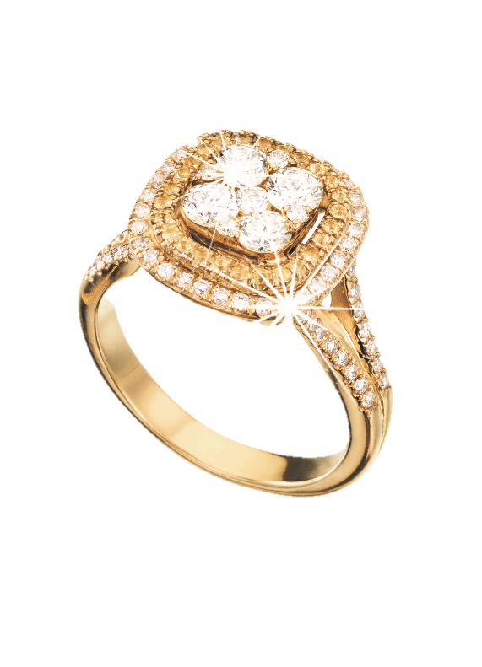
Strong and reputable brand
The Royalty brand represents quality and style to the Israeli consumer.
The level of service is among the highest in the industry – the company views Customer Service to be an integral and supremely important part of its relationship with its customers. The company adheres to the highest level of credibility and professionalism.
High customer loyalty, positive purchasing experience and satisfaction – approx. 80% of the company’s sales are purchases made by customers in the Customer Club. The majority of these customers make several purchases throughout the year.
The chain advertises in all of the different types of media in order to maintain high awareness among the customers. The company recently launched its first television campaign, which led to a sharp increase (50%!) in sales during that period.

Slide 5
Strong financial performance
The company has been profitable since the day it was founded.
Stability – the company has maintained profitability even during the economic crisis of 2008-2009.
Growth – consistent growth in the company’s revenues and EBITDA between 2009 and 2012.
The company has consistently maintained a high gross margin of over 50% despite the fluctuations in the price of gold and exchange rates.
The company has a conservative balance / minimal leverage level.
Extensive distribution in the Israeli jewelry and watch market
The chain has the broadest store deployment in Israel - 47 stores.
Standardized high-end shop design – highly operationally effective, appeals to a broad and diverse market share – from the middle class to the upper class (5th to 9th percentiles).

Slide 6
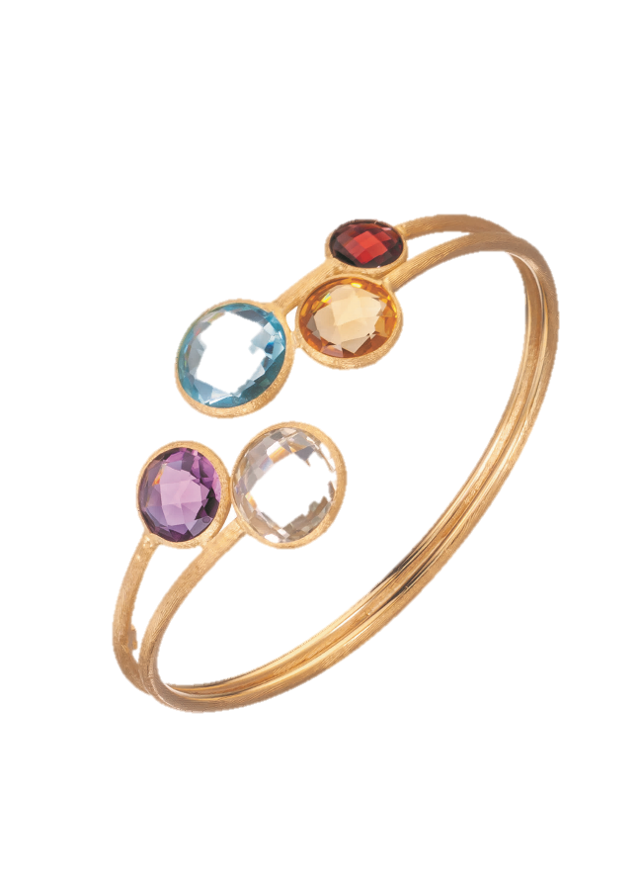
Company Strengths
Wide variety of products, constant innovation, excellent management, opportunities for growth
Wide variety of products, unique and stylish design
The chain has a wide variety of products (over 5,000 items).
Stylish and renewing design – The jewelry collections are refreshed 3-4 times a year. The company has extensive experience in jewelry design and in selecting collections that are compatible with the tastes of Israeli consumers.
Business development – in 2012, the chain expanded (without advertising) its activity in the engagement and wedding ring segment. As a result, the customers bought more items – a customer that buys a ring generates on average additional income of approx. 100%+ of the cost of the ring.
The first company in Israel that launched a private label in the industry in 1982.

Slide 7
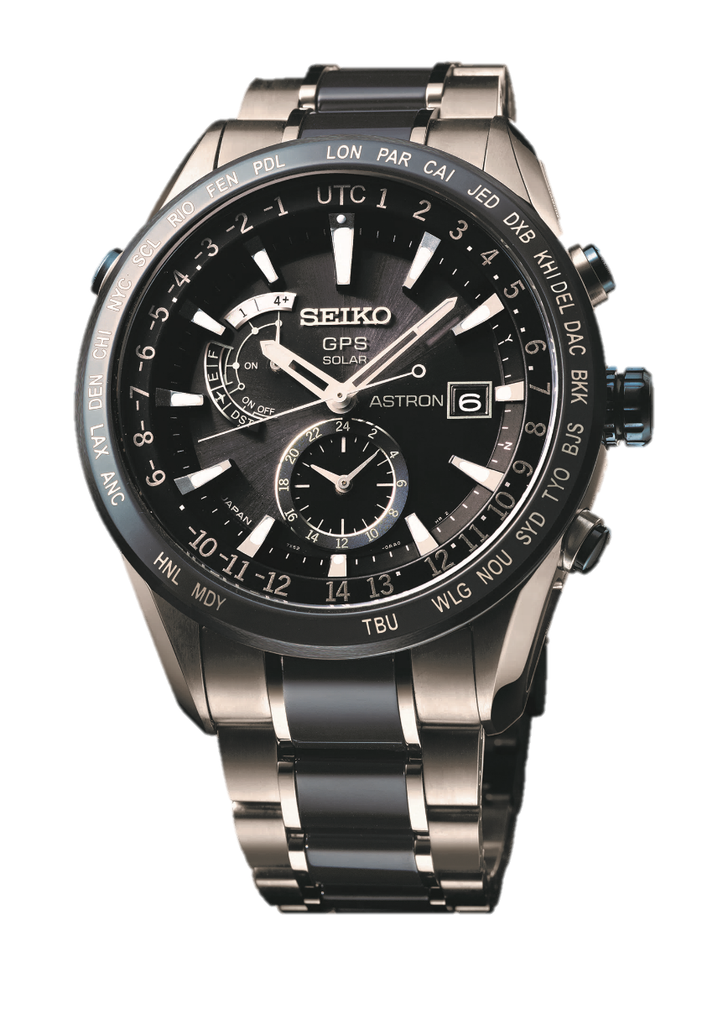
Management capability, extensive experience in the industry
Narrow, quality and experienced management backbone with proven results
Extensive experience and knowledge in choosing successful shop locations
High efficiency in opening new branches
Familiar with the entire value chain of the industry (manufacturing, import and distribution) for many years
Entry barriers and growth opportunities
Serious entry to the industry requires significant capital investment to open shops and acquire inventory.
Exclusivity of leading brands – Seiko has expressed confidence in the company for over 25 years.
Decentralized market – opportunities for acquisition and expansion

Slide 8

History
Many years of experience, competitive advantage

Slide 9
1977
Company founded
Operated 7 jewelry stands at SHEKEM
1978
Consolidation with Kolbotime
Operated 50 points of sale
1982
Launched Ferrari - the first Private Label in the Israeli watch industry
It was the company’s founders’ idea to sell a branded and designer watch as an international brand but the watch is actually manufactured exclusively for the company according to its specifications.
1986
Received exclusive franchise of Seiko watches in Israel
Over 25 years of experience expressing confidence in the company
1988
Opened the first store
The company’s first store under the Morale name in Ashkelon
1994
Opened the first store under the Royalty brand name

Slide 10
1998 – 2002
The SHEKEM closed and the Mashbir collapsed
Reducing the company’s points of sale and nationwide deployment
2001 – 2003
Accelerated opening of the Royalty stores
As a result of the Mashbir’s collapse, work commenced on opening 7/8 stores per year
2007
Launching a Customer Club for the chain
There are currently around 50,000 customers registered in the club, around 30,000 of which are active (they paid membership fees in the past two years)
2012
Expanding the wedding ring segment
Generates additional “traffic” at the stores and increases the number of items the customer buys (a customer that buys a ring generates on average additional income of approx. 100%+ of the cost of the ring).
2013
48 stores nationwide
2 more stores will open during the first half of the year and by the end of the year the 50th store is expected to open

Slide 11
Company Activities
Omtime operates a chain of 48 jewelry and watch stores under the Royalty brand, with a focus on two main activities:
  Selling gold and diamond jewelry (approx. 80% of the company’s sales) manufacturing, importing, and marketing jewelry (including engagement and wedding rings) at the Royalty stores. Around 60% of the company’s jewelry is manufactured in Israel and the rest is purchased through foreign suppliers (Turkey, Hong Kong, Thailand and Italy)
  Watch sales (approx. 20% of the company’s sales) – exclusive representation of international brands like Seiko, Escada, Elle, Pulsar, Saint Honore, Nina Ricci and Milus. Also, the company has the Ferrari private label, a brand of watches that is designed and manufactured according to the company’s specifications. Some of the brands are sold exclusively at the chain’s stores and some are exclusively distributed by the company in Israel.

Slide 12
Manufacturing, Logistics and Operations
Manufacturing
The company has a manufacturing array of diamond and precious stone jewelry.
Complex jewelry and jewelry with large stones (approx. 60% of the total jewelry sales) are manufactured in Israel via a secondary manufacturing array, which provides the company with inlay and casting services. The company has a close and long-standing relationship with these suppliers.
Basic jewelry (without stones or with small stones) comprises around 40% of the total jewelry sales and is purchased as a finished product from foreign suppliers. The majority of purchases are made from Hong King, Thailand, Turkey and Italy.
Ferrari watches – manufactured in Hong King according to company-dictated specifications and standards.

Slide 13
Logistics and Operations
The store inventories are managed centrally from the company’s headquarters by the ERP system, which is customized to the company’s needs.
The company has around 5,000 items.
The jewelry and watches are distributed to the stores in the chain via company couriers that visit all the chain’s stores twice a week (except for Eilat).
Using the ERP system, the company can track online the products sold and the stores’ need for new inventory. The requisite stock is manufactured, imported or distributed accordingly.
Omtime markets the various collections in the chain’s stores based on years of experience and knowledge, market analyses and segments.

Slide 14
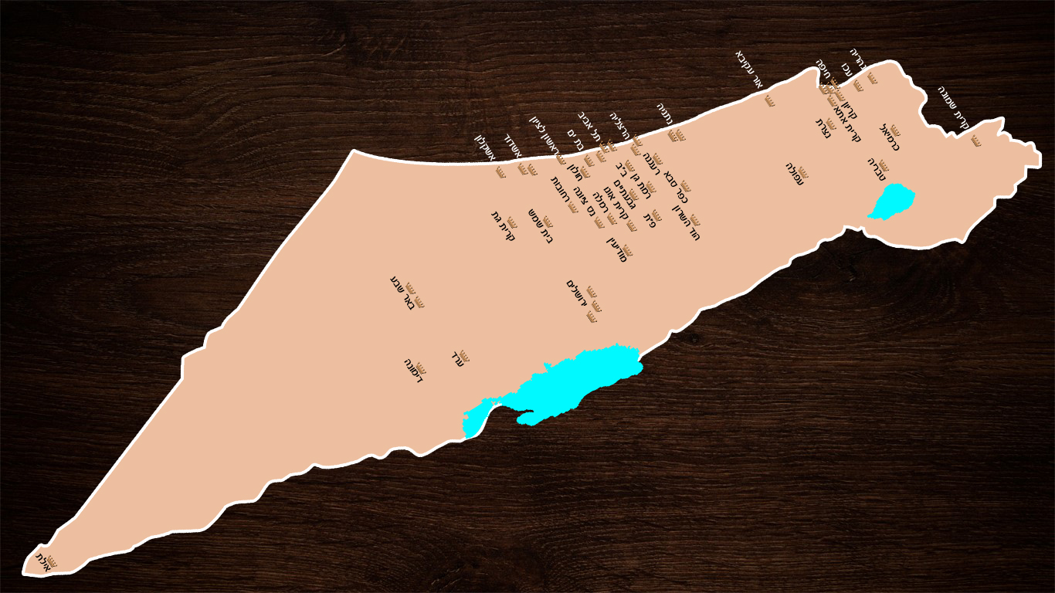
Nationwide Distribution

Slide 15
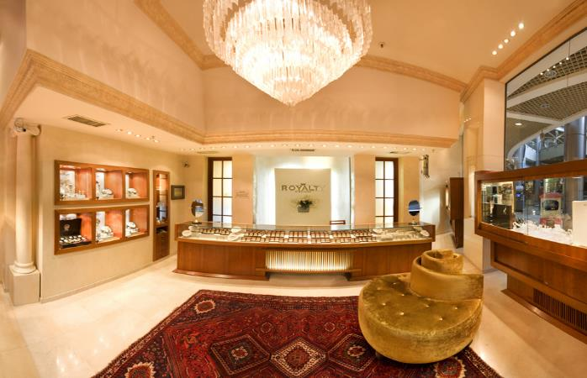
The chain has 48 stores around Israel. The company is planning to open the 50th store by the end of 2014.
Approx. 80% of the chain’s stores are located in leading shopping malls. The stores are opened only after the mall’s sales potential is assessed and the store’s location in the mall is examined.
The company has a great deal of experience and knowledge in examining the parameters for choosing the store locations and the properties in
which it rents. (only 2 stores have closed within
18 months since they were opened – Allenby and
Karmiel due to low profitability)
The chain’s stores have a standardized design that
is geared to the upper-middle class in accordance
with the company’s strategy.
The stores range from 30m² to 55m² in size.

Slide 16



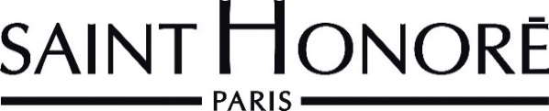





Watch Marketing and Sales
The company exclusively represents the following watch brands in Israel:
  Exclusive import and sale at the Royalty stores: Escada, Saint Honore, Nina Ricci Milus and Elle.
  Import and distribution: Seiko (over 25 years), Pulsar (from the Seiko group) and Lorus .
  Private Label: Ferrari – The first Private Label in Israel that was launched by the company’s owners over 25 years ago – the watch is manufactured exclusively for the company and according to its specifications.
The company sells over 25,000 watches a year, approx. 9,000 of which are the Ferrari Private Label and approx. 10,000 of which are Seiko.

Slide 17
Customer Club
In 2007 the company launched a customer club, which approx. 30,000 customers have joined to date. Since 2010, the company began charging membership fees (99 ILS for two years) and as of the beginning of 2013, approx. 30,000 members paid their Customer Club membership fees.
Approx. 80% of the company’s sales are to returning customers that belong to the Customer Club.
Membership in the Club gives several benefits:
  10% discount for jewelry purchases
  5% discount for watch purchases
  Collecting points – 5% of the value of the purchase is collected as points (worth their value in cash for future purchases)
  Jewelry cleaning once a year
  Birthday bonus
Since 2013, the company has been working to increase its sales share and the number of members in the Club using a company that specializes in segmented communication and direct marketing.

Slide 18
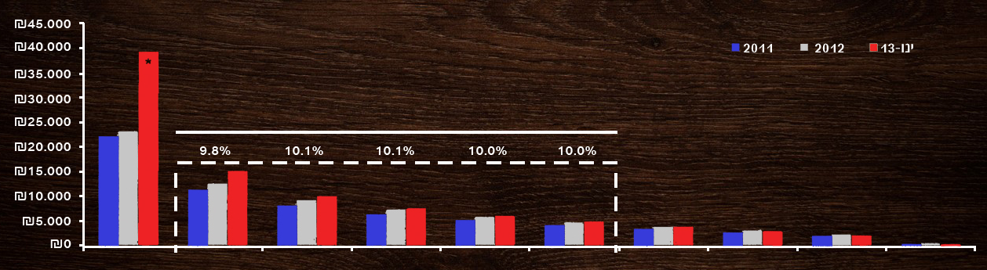
Since 2013, the company has been working to increase its sales share and the number of members in the Club using a company that specializes in segmented communication and direct marketing.
Average Revenue per Customer Club Customer According to Percentiles (in ILS)
% of the total
10th percentile
9th percentile
8th percentile
7th percentile
6th percentile
5th percentile
4th percentile
3th percentile
2th percentile
1th percentile
*Neutralizing a single purchase of a Club member during January 2013 by approx. 300,000 ILS.

Slide 19
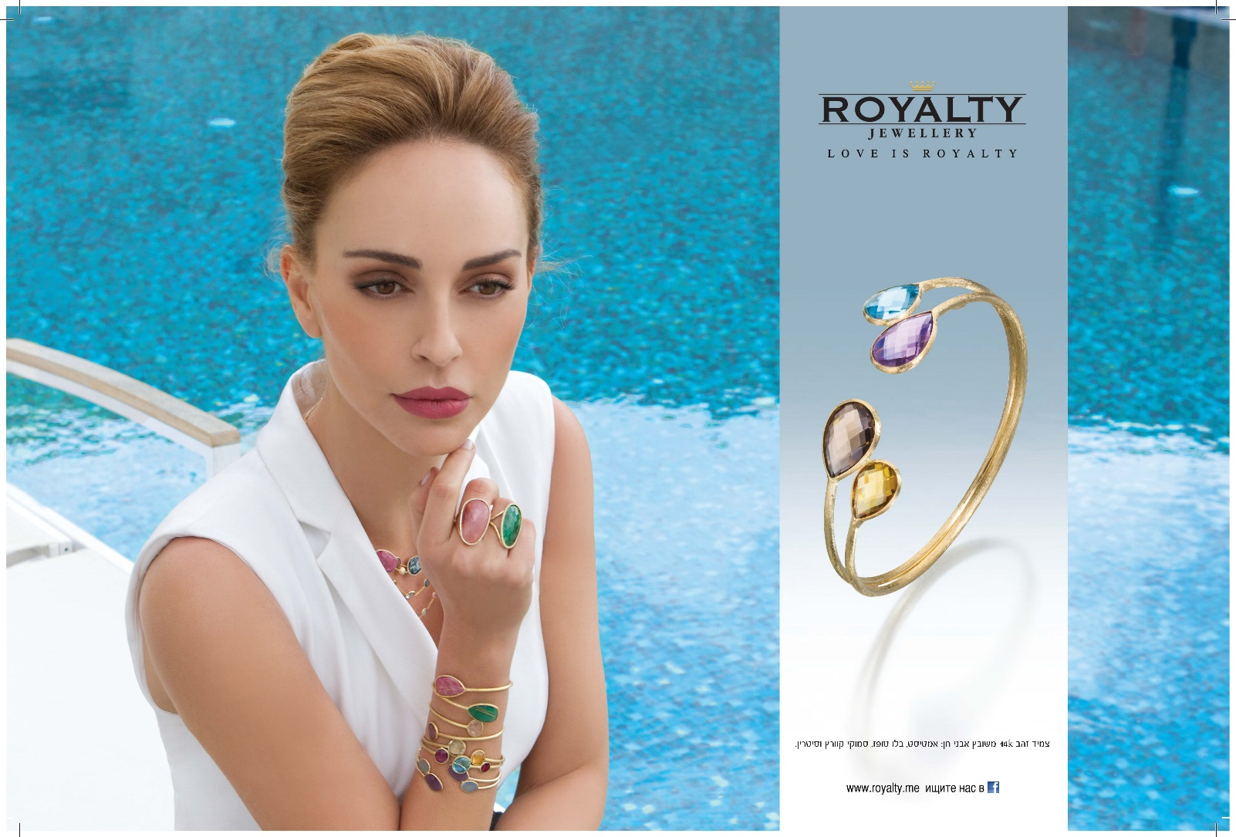
Advertising
“Love is the most valuable thing, at Royalty we just give it a helping hand”
The company invests a great deal of resources in advertising and employs all the different media channels (television, radio, press and Internet). Miri Bohadana, a well-known model is the chain’s spokesmodel.

Slide 20

In March 2013 the company launched its first television advertising campaign, costing 1.1 million ILS. The campaign was an overwhelming success and this advertising medium proved to be very effective – this month (which included Passover this year) the company sold approx. 50% more than last year (growth of approx. 4.6 million ILS).

Slide 21
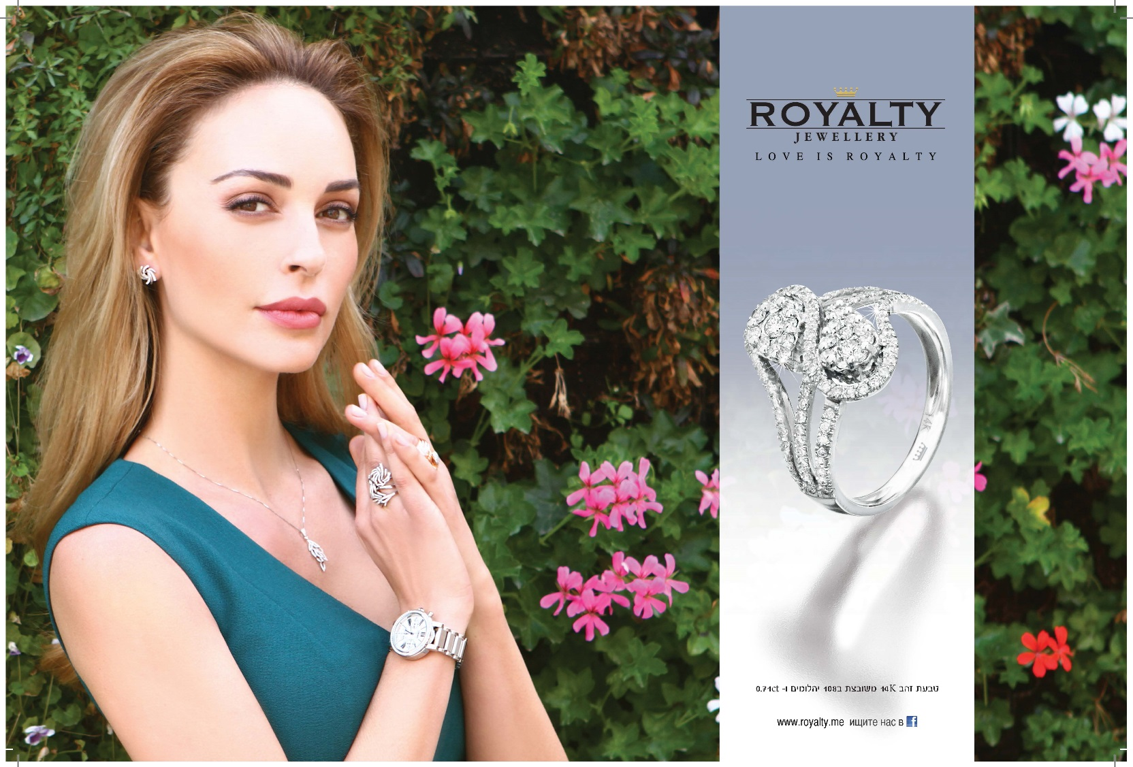
The company’s ads and commercials are independently produced by the company’s design department, except for some of the watch brand ads that the company receives directly from the brand.
The company is raising awareness for the brand by giving back to the community and launching the “Designing a Future” project, where famous women design jewelry. The revenues from the jewelry sales go to a help center for victims of rape and sexual assault.

Slide 22

Market and Competition

Slide 23
The Jewelry and Watch Market in Israel
Decentralized Market without a Dominant Player
The jewelry and watch market was valued at approx. 1.75 billion ILS in 2010, an increase of approx. 3% relative to 2009.
More than half of Israelis (53%) bought jewelry during 2011.
Approximately 1,700 stores are active in the market. Of which , 55% sell products in the intermediate price range (200 ILS to 1,000 ILS).
Source: BdiCoface, September 2011
Referring to the chains: G.R.A.S., Magnolia, Ravid Jewelry, Sub Chrono, Michal Negrin, Italy Gold, Amaro, Zman Watches and Jewelry, Planet World of Watches,
The Jewelry Bursa, Diva, Miller Jewelry, Royalty, Silvario, Daniel Jewelry, and Padani Jewelry
Assessments for H. Stern revenues in 2012 according to information published about the company in the press in April 2013

Slide 24

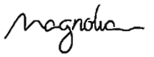


Additional characteristics:
  Women’s purchases account for around 75% of the purchases in the industry.
  Seasonality – in the weeks preceding Passover and Rosh Hashana, and during the summer months (June-September), there is a 25% growth in sales.
  The main chains operate around 320 branches and concentrate around 65% of the total sales in the industry.
Key Data about Competing Chains
 | Chains | Turnover (M ILS) 2010 | Employees¹
 | 7 stores + 12stores in hotels / airports | 260³ | 330
 | 80 stands in Israel (silver) | 220 | 550
 | 30stores + 14 stands (silver) | 80 | 350
 | 25 stands at the Mashbir LaTzarchan | 65 | 180

Slide 25
The Jewelry and Watch Market in Israel
Jewelry Sales Comprise Approx. 70% of the Market (1.23 billion ILS)
Source: BdiCoface, September 2011

Slide 26
Competition
The Leading Company in Israel
Geographical distribution – The company has a wide geographical distribution and extensive experience in selecting the store locations and the properties in which the company rents. This distribution is an important parameter in the service the Israeli consumer expects and it comprises an important part of the company’s success in the industry and an advantage in negotiations with property owners.
Branding – The chain is perceived as prestigious due to the shopping experience (standardized and meticulous store design) and the large and high quality collection.
Service – The company provides its customers with reliable, professional and efficient service at the highest level, which is supported by a service and repair center. The company sees customer service as an integral and important part of its relationship with its customers.

Slide 27
Customer loyalty – The majority of customers in the industry choose to buy at a store that offers the best price or the best discount. However, customers are also seeking a brand that they perceive to be good quality even if it is relatively expensive compared to similar products. Thanks to the Customer Club, advertising in the various media, and offering significant discounts, the company has managed to maintain high customer loyalty. As stated, approx. 80% of the company’s sales are made to returning customers in the Customer Club.
In light of the company’s presence throughout the industry’s value chain (manufacturing, importing and distribution), Omtime can enter a variety of additional areas of business with minimal barriers and at a high response time. Moreover, since the company dominates the entire value chain, it can customize each part of the chain according to its needs.

Slide 28
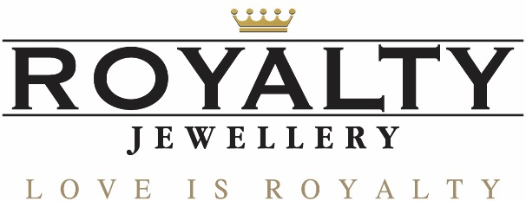










Royalty’s Positioning in the Industry
Royalty appeals to the largest segment of customers and has the broadest coverage in Israel
Distribution – Number of Branches
Prestige
Fashion
Branding and Price Range

Slide 29
Growth Engines
Import
We have begun preliminary overtures and with the improvement in foreign markets (namely the U.S.), there is a good chance of selling to customers abroad. Our prices are extremely competitive and our products are of a very high quality.
Establishing a network outside of Israel together with a local investor or franchise (negotiations have commenced)
Expanding the variety of watch brands (in progress)

Slide 30
Penetrating and Expanding Supplementary and Complementary Segments
Continuing to expand the wedding ring segment using advertising – generating more “traffic” at the stores and expanding the product range.
Increasing watch sales – the company’s goal is to change the sales mix so that watch sales comprise 25% of the total sales.
Penetrating the pen and cufflink segment

Slide 31
Service for Watches and Jewelry
Establishing a goldsmith and watch and jewelry repair service at several select stores. A skilled employee will sit at these branches and make “simple” repairs to watches and jewelry. This move is expected to increase the select stores’ annual turnover by approx. 300,000 ILS.
Customer club- Expanding the Club and customer revenues – using a company that specializes in segmented communication and direct marketing
Online sales - Selling items online through the company’s website - the company’s website is ready to be launched.

Slide 32
Appendix
Key People
Uri Falach
Controlling Shareholder and CEO
Founded the company together with Leah Falach in 1976, has a Bachelor’s degree in Psychology. Served as Deputy Mayor of Bat Yam before he founded the company.
Leah Falach
Controlling Shareholder
Founded the company together with Uri Falach in 1976. Has a Ph.D.

Slide 33
Shahal Falach
VP of Operations and Sales
Joined the company in 1994. Began working at the company as a watchmaker and is currently a VP – responsible for the company’s procurement, design and positioning.
Shuvael Falach
Director of Marketing
Has been working at the company since 2002, has an M.B.A.

Slide 34
Arie Skajo
Director of Jewelry Manufacturing
Started working at the company in 1978 as a salesperson and then as a regional manager for 20 years. Arie specializes in gold and diamond jewelry and for 14 years has served as Director of the Manufacturing Department and Head Buyer.

