Slide 1



Cairo International Fair
9 – 18 March 2022

Slide 2
TABLE OF CONTENTS
1
5
2
6
3
4
ABOUT US
Media Coverage
Facts about CIF
The History of CIF
Int. Participation
7
Facilities
Local Participation
8
PICTURE ALBUM

Slide 3
1
ABOUT US

Slide 4
About us
Cairo International Fair is the most prominent international annual event organized by Egypt Expo and Convention Authority (EECA). It plays a major role in deepening the bonds of economic cooperation between Egypt and all the countries participating in the exhibition.
The exhibition plays a significant role in supporting the Egyptian economy and opening new markets, not only to the Egyptian product, but to products of all countries participating in the exhibition.

Slide 5

2
The History of Cairo Fair

Slide 6
The History of Cairo Fair
The exhibition industry started in Egypt in the 19th Century when Egypt participated for the first time in Paris International Exhibition in 1867 where khedive Ismail paid a visit to the Egyptian pavilion which gained gold, silver and bronze medals for the good quality of its products. Also King Fouad inaugurated the First Cairo Agro- Industrial Exhibition which took place at the Exhibition Grounds in al Jazeera in 1897.
In 1980 CIF moved from the Exhibition Grounds in Al Jazeera to Exhibition Grounds in Nasr City .
In 2019 CIF moved to Cairo International Conference Center.

Slide 7

3
International participation

Slide 8













INTERNATIONAL PARTICIPATION
The most prominent contributions of Arab, African and foreign countries in previous years:
KENYA
kUWAIT
SUDAN
IRAQ
UAE
THAILAND
INDONESIA
JAPAN
CHINA
ALGERIA
INDIA
SERILANKA
TOGO

Slide 9
4
National PARTICIPATION

Slide 10
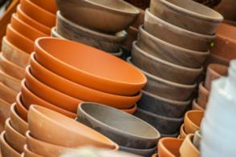
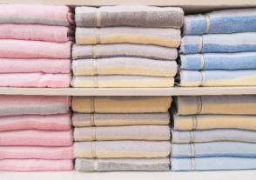
National PARTICIPATION
National Egyptian companies.
Holding companies .
Handicrafts chamber.
Ministries and business sector .

Slide 11


National PARTICIPATION
The display includes :
( Electrical Devices, House wares, Carpets and Rugs, Textiles and furnishings , Ready made clothes, food industries, Chemical and cosmetics industries - leather goods - wood and furniture industries.

Slide 12

5
MEDIA COVERAGE

Slide 13

MEDIA
COVERAGE
Cairo International Fair receives distinguished media coverage due to its economic status on both local and international level. This Media coverage includes press, visual and audio media:
Visual Media: The exhibition site on the internet: www.cairofair.com
Audio Coverage : Radio Channels : 90, 90 , Nogum FM, Nagham FM and Shaabi
Print Media : Newspapers, magazines, billboards in main squares and streets around the exhibition , ( outdoor unipoles) , metro stations.
Exhibition Catalogue : It lists countries and companies names’ and data to facilitate communication between visitors and exhibitors.

Slide 14
6
FACTS
ABOUT CIF

Slide 15
Information about
Cairo International Fair
Session number: - 55
Duration: - From 9– 18March 2021
Place: - Cairo International Convention and Exhibition Center – Egypt
Organizer: - Egypt Expo and Convention Authority(EECA)
Exhibition Area: Targeted promoted area 27,000 sq.
Entrance: -From 10 am till 8 pm (visitors)
Countries: - Many countries and foreign companies

Slide 16
7
Facilities

Slide 17




Facilities and
services for the visitors
Food Court in Osiris Garden
restaurants inside the halls.
Customs area for foreign exhibits during the fair.
Information center.
Parking areas.
kids area in Osiris Garden.

Slide 18

Photo Gallery
8

Slide 19
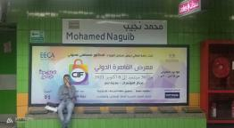
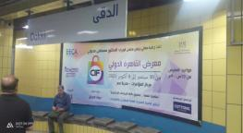
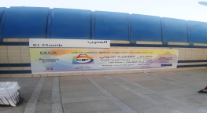

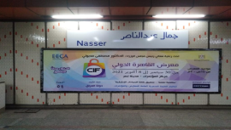
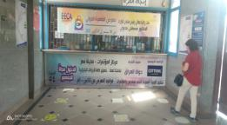
Advertising Campaign
Underground

Slide 20
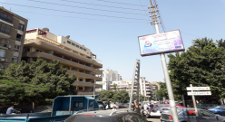
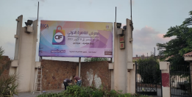
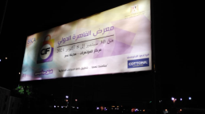

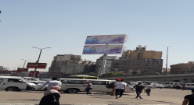
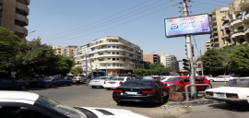
Advertising Campaign
Outdoor Ads

Slide 21
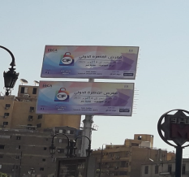
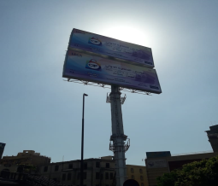
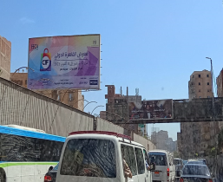

Slide 22
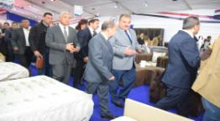
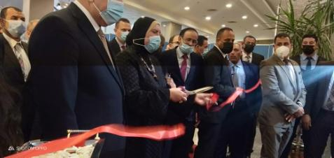
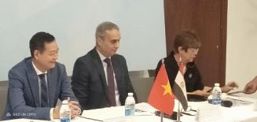
Previous OPENING Ceremonies

Slide 23
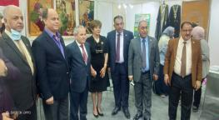
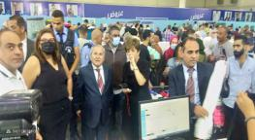
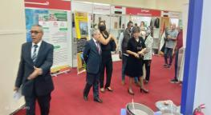
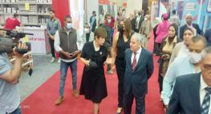
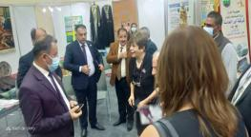
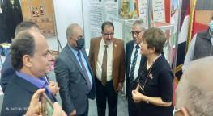

Slide 24
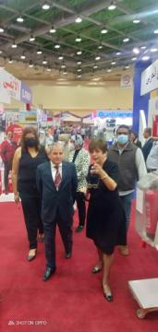
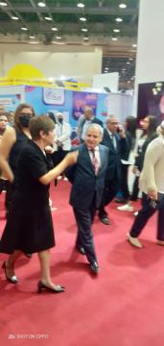
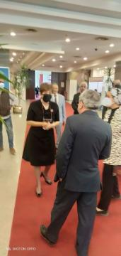
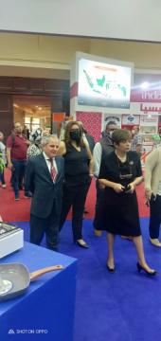

Slide 25
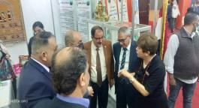
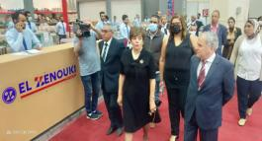
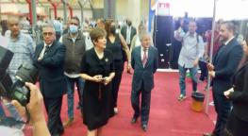


Slide 26
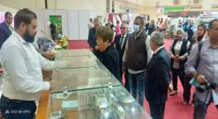
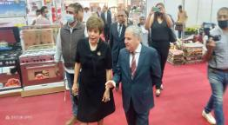
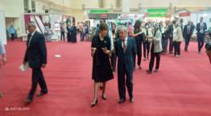
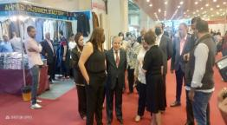
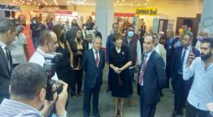
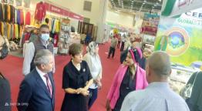

Slide 27
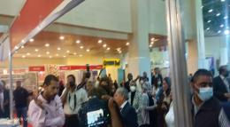


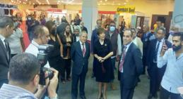
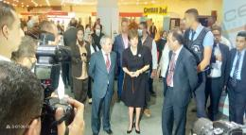
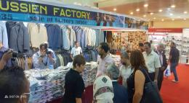
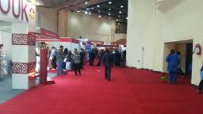

Slide 28
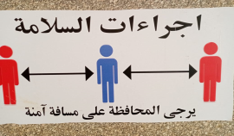
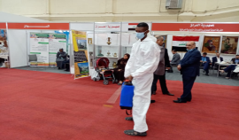
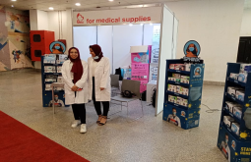
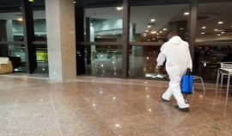
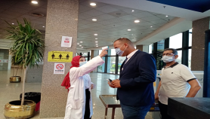
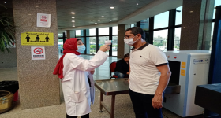
Exhibition Activities
Precautionary Measures

Slide 29
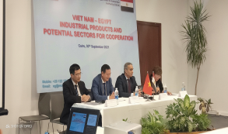
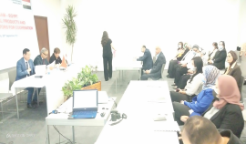

Exhibition Activities
Seminars

Slide 30




Exhibition Activities

Slide 31







Slide 32







Slide 33







Slide 34





Slide 35





Slide 36
THANKS
Waiting for your participation

