Slide 1
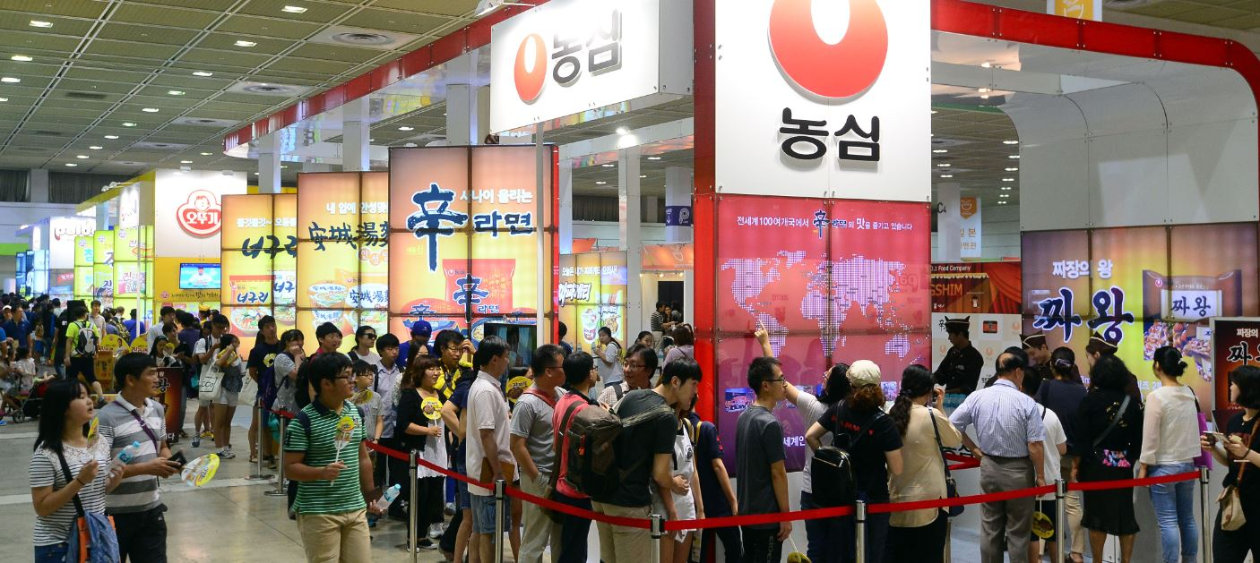





Newsletter
Korea International Ramen Fair 2017 www.ramenfair.com
In 1963 instant noodles (also known as ramen) was first introduced in South Korea. After more than
50 years of instant noodles history in South Korea, now ranked as number one to consume the most Instant
noodles in the world. South Korean consumes average of 76 packages each year, total domestic production of
instant noodles estimated about 816,000 tons per year, and market worth around 2.6 Trillion KRW.
The previous event, Korea Int’l Ramen Fair 2016, ended with a great success, attended 71,000 visitors
during three days. Successfully, “Korea International Ramen Fair 2017” will provide the opportunities for
oversea noodle industrialist to attract domestic consumers and to discuss and share Information & idea with
South Korean noodle industrialist.
Especially, this year’s event will be extending overseas business pavilion and planning a Business Matching
Program to help overseas companies advance into Korea market by having an opportunity the Korean buyers.
I. Expo Profile
Event Name
Event Date | Sep. 9th (SAT) to 11th (MON), 2017 / Opening Hours: 10:00 ~ 18:00
Event Venue | COEX Hall D / Seoul, Korea
Event Scale | 5,184㎡ / (250 booth)
Organizer | Korea International Ramen Fair 2017 “Secretariat”
Sponsor
II. Contents
Food | Domestic & Oversea instant ramen, PB Ramen, Noodles of various kind: (Dried, Raw, Frozen, Udon, Pasta), Rice, Wheat, Kimchi, Eggs, Dumpling, Cheese, Rice cake, Kimbap (Seaweed), Ingredients, Soups, Seafood, Processed beef, etc.
Education | Cooking institution, Culinary school, F&B management school, etc.
Service | B2B Consulting firms, Market research firm, etc., Food truck, etc.
Supply & Facility | Logistic, Security system, POS, Electronic induction cooker, Interiors, Equipment & Installation, Kitchen appliances, etc.

Slide 2
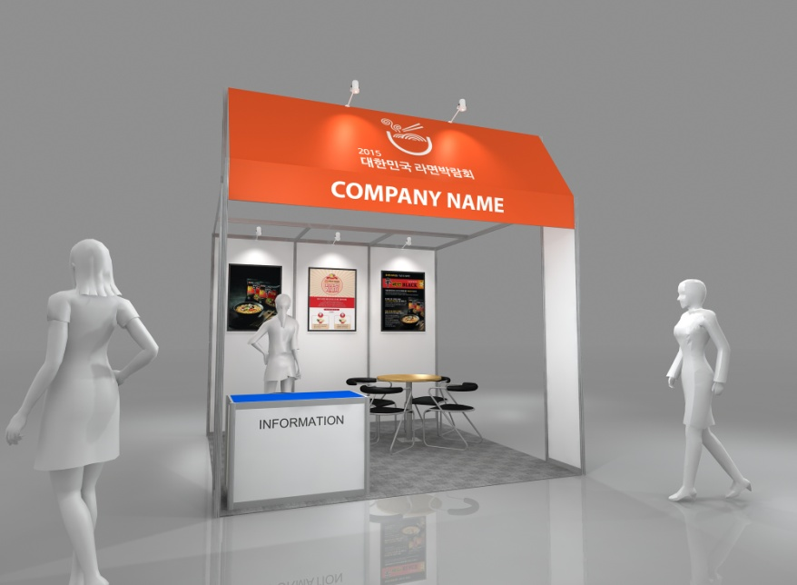
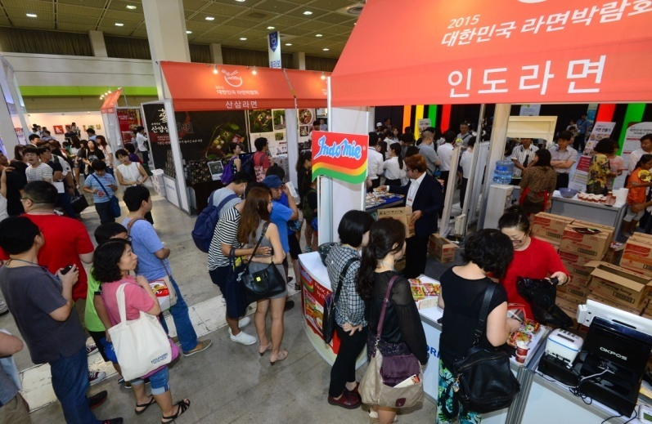
III. Participation Info
Classification | Space | Participation fee | support of a government
 |  | General Application Deadline: Aug 17th, 2017
Space only [non-furnished] | 1Booth (3m X 3m=9㎡) | 2,300,000 KRW | 1,000,000 KRW
Shell Scheme Package [fully-furnished] | 1Booth (3m X 3m=9㎡) | 2,500,000 KRW
DOWNLOAD APPLICATION FORM
IV. Booth Info
Exhibition space | 1Booth(3m X 3m=9㎡)
Carpet | Inside the booth
Display company’s name | Company’s name board
Lights | 5 spotlights, 1 fluorescent lamps
Desk | 1 info desk
Chair | 1 chair
Electricity | 220V Socket, 1kw electricity(per booth)
V. Contact
Inquires (Secretariat) | Korea International Ramen Fair 2017 “Secretariat” ADD: Maekyung Media center, 190, Toegye-ro, Jung-gu, Seoul, Korea (ZIP CODE : 100728) TEL: +82-(0)2-2000-5807 FAX: +82-(0)2-2068-8643 EMAIL: ramenfair@naver.com WEB: www.ramenfair.com
Korea International Ramen Fair 2017 www.ramenfair.com

